Slide 1


Foundations of
Scientific Computing
(SciComp 101)
Dave Biersach
dbiersach@bnl.gov
Session 05
Cartesian Graphs and Conic Sections

Slide 2
Session 05 – Goals
Leverage the NumPy package to create arrays using np.linspace()
Understand vectorized operations that implicitly operate on an entire NumPy array with just one algebraic expression
Use NumPy’s slicing syntax to extract specific subarrays from a larger array
Plot 2-D equations using the Python package matplotlib and its pyplot module
Relate the pyplot figure object to its axes object, and learn how to decorate plots with titles, labels, grids, etc.
Learn how LaTeX can display proper mathematical symbols

Slide 3
Session 05 – Goals (cont.)
Draw a line graph using numpy arrays to hold the independent and dependent variable values
Draw the parabola, circle, and ellipse conic sections
Leverage the symmetries in conic sections to reduce the calculations required to plot each curve
Visualize the Fahrenheit, Celsius, and Kelvin scales

Slide 4
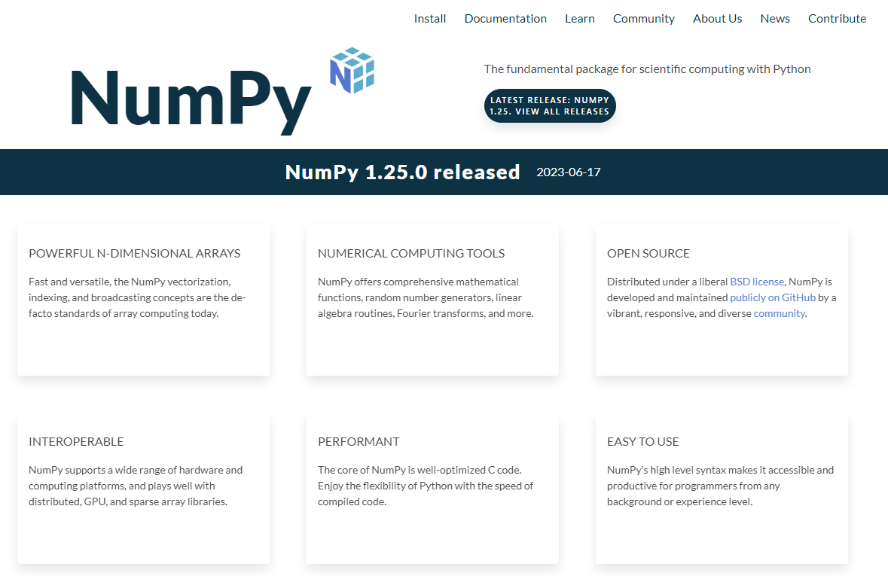
Extending Python via the numpy Package
https://numpy.org

Slide 5
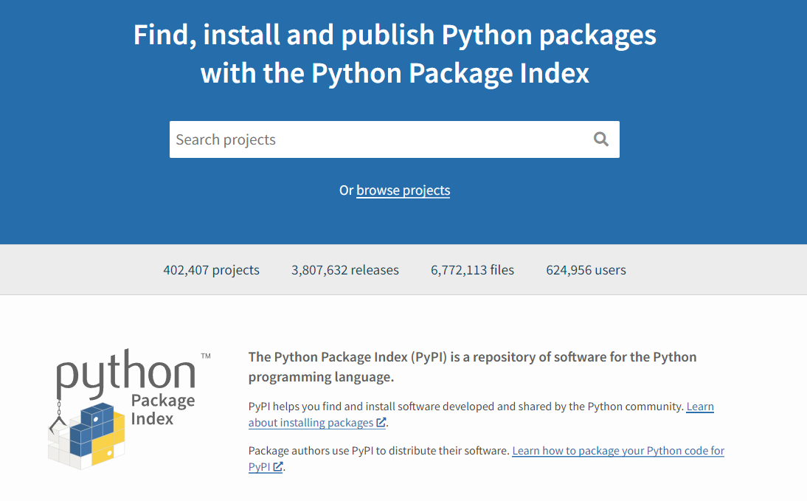
About PyPI (Python Package Index)
https://pypi.org

Slide 6
Numpy Arrays
A numpy array is a set of elements having all the same type
An individual element in an array is accessed by using its index number within square [] brackets
Every element has a unique index number
No two elements share the same index number
The first element has an index = 0
For 1D numpy arrays, the len() function (or size property) returns the length of an array, which is the number of elements in the array
Why is the last element in an array at [size – 1]?

Slide 7
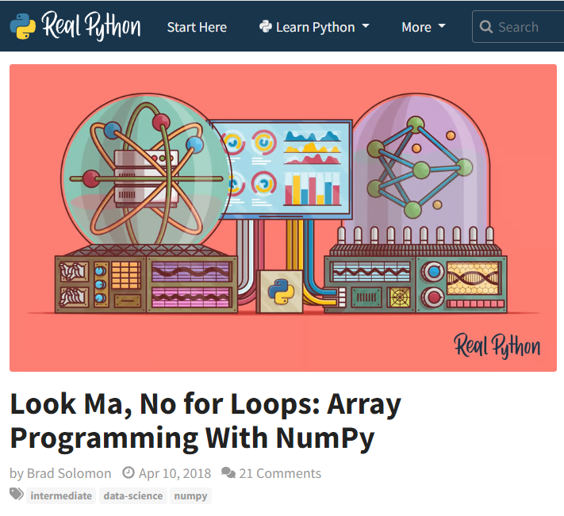
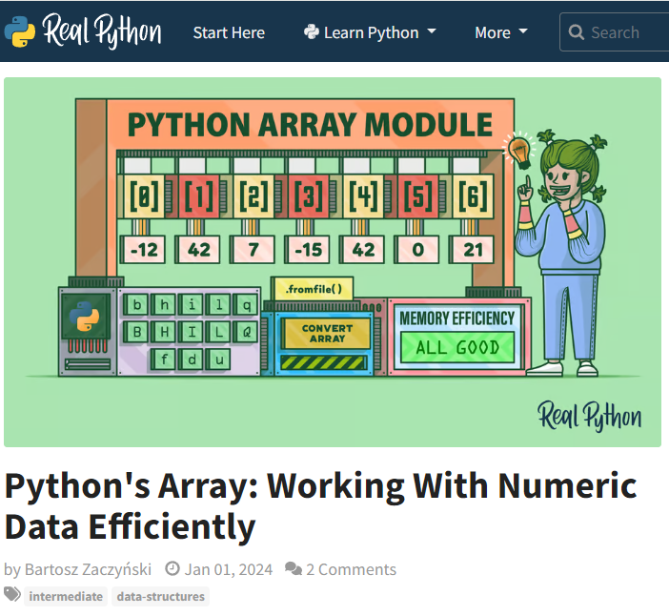
NumPy Arrays
https://realpython.com/numpy-array-programming
https://realpython.com/python-array

Slide 8
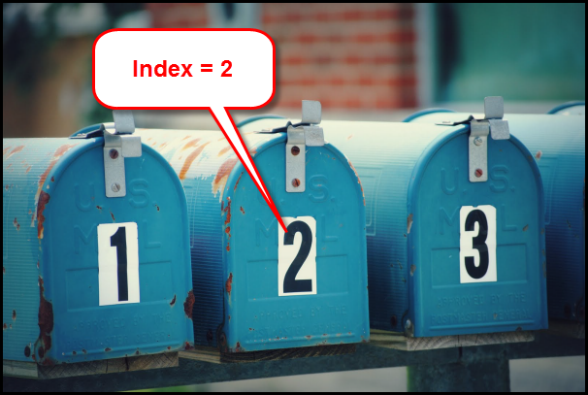

Index Number versus Element Value
array_name[2]
The first addressable element in an array is at index 0

Slide 9
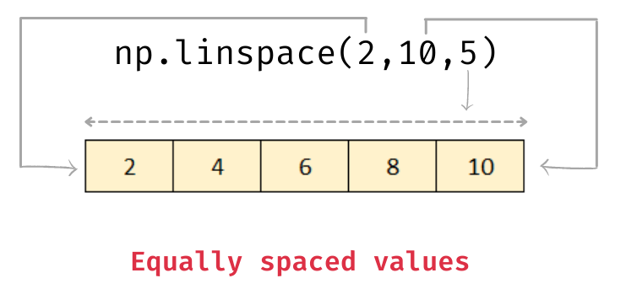

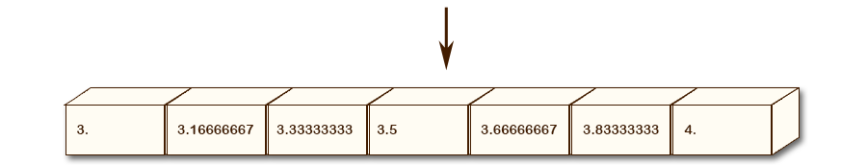
A Numpy Linearly Spaced Array
Creates a "street" of mailboxes where the values inside are equally spaced between [start, stop]
You must provide both
start and stop values!
The stop value is inclusive
The third number is the number of mailboxes you want in the array
Index [0]
Index [6]
np.linspace() figures out the step size based on the range of the linear space and the number of elements you request

Slide 10
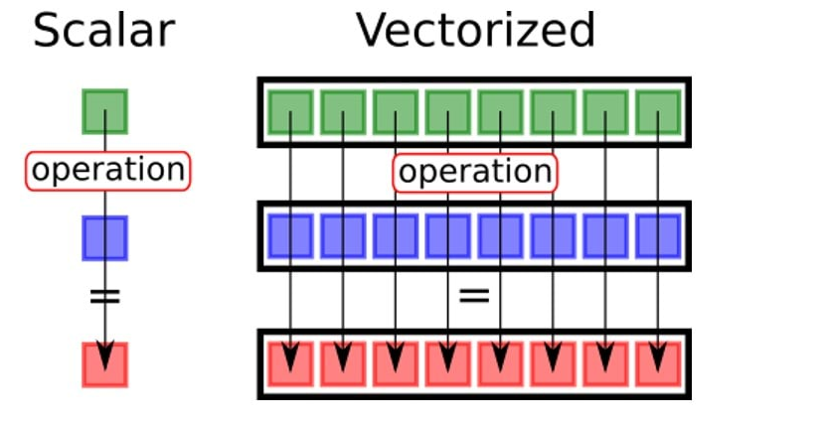


Numpy Vectorized Operations
3
a
*
*
5
b
15
a[n]*b[n]
A vectorized scalar operation applies a function to every element in a single array (to each individual cell)
A vectorized array operation applies a function to elements in both arrays that have the same index value
$c=a∗3$ or $c=\left|a\right|$
$$c=a∗b$$

Slide 11
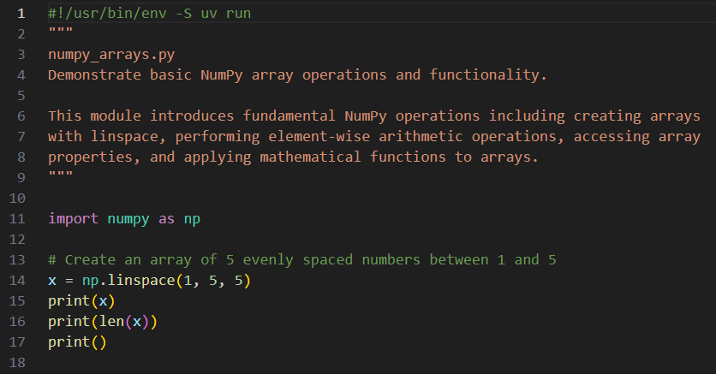
Edit numpy_arrays.py
You must type in this code
np is now an alias for the full package name numpy
①
②
③
④
⑤

Slide 12


Run numpy_arrays.py
①
②
Index Number
[0]
[1]
[2]
[3]
[4]
Array x
Element Value
1
2
3
4
5
The first addressable element in an array is at index 0

Slide 13
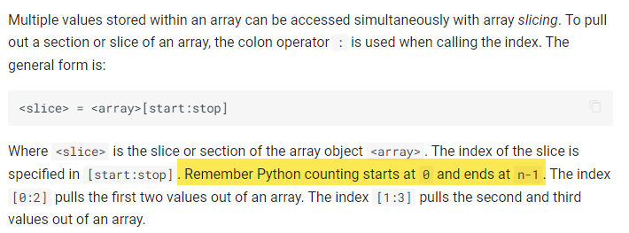
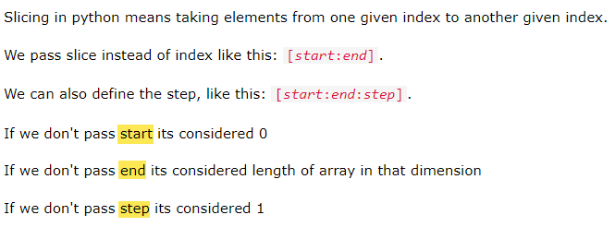
NumPy Array Slicing
https://problemsolvingwithpython.com/05-NumPy-and-Arrays/05.06-Array-Slicing
https://www.w3schools.com/python/numpy/numpy_array_slicing.asp

Slide 14
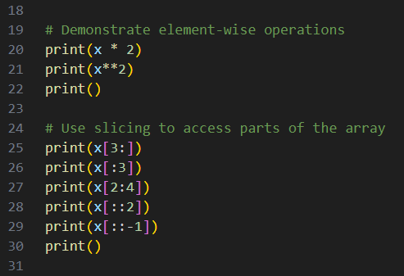
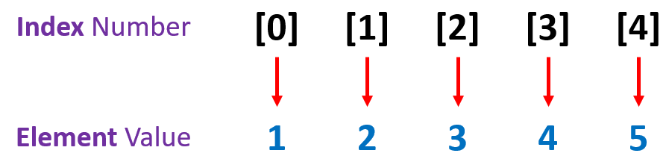
Edit numpy_arrays.py
You must type in this code
①
②
③
④
⑤
⑥
⑦
⑧
[start = 0 (inclusive) : stop = size (exclusive) : step = 1]

Slide 15
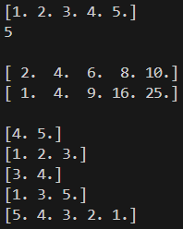


Run numpy_arrays.py
$$x$$
①
$$2x$$
②
$$x^{2}$$
③
x[3:]
④
x[:3]
The first addressable element in an array is at index 0
⑤
x[2:4]
⑥
x[::2]
⑦
x[::-1]
[start = 0 (inclusive) : stop = size (exclusive) : step = 1]

Slide 16
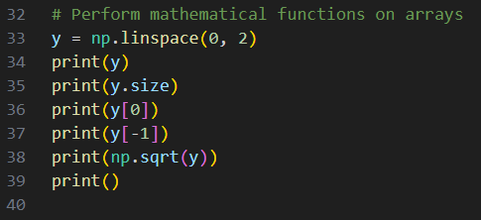
Edit numpy_arrays.py
You must type in this code
①
②
③
④
⑤
⑥
⑦
A np.linspace() with no given length
assumes a default size of 50 elements

Slide 17
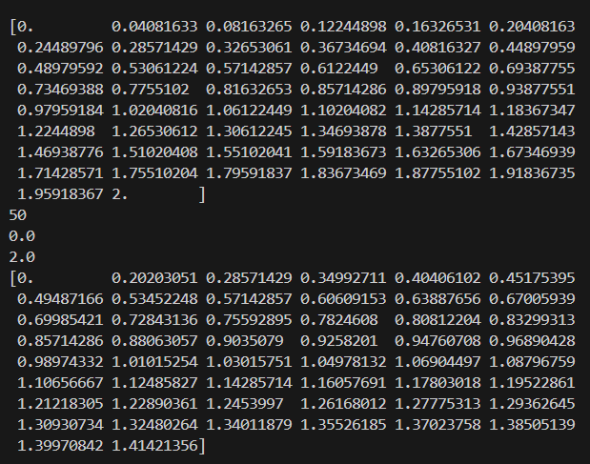


Run numpy_arrays.py
①
$$0≤y≤2$$
②
③
④
⑤
$$\sqrt{y}$$

Slide 18
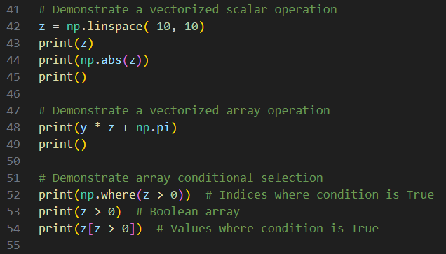
Edit numpy_arrays.py
You must type in this code
①
②
③
④

Slide 19
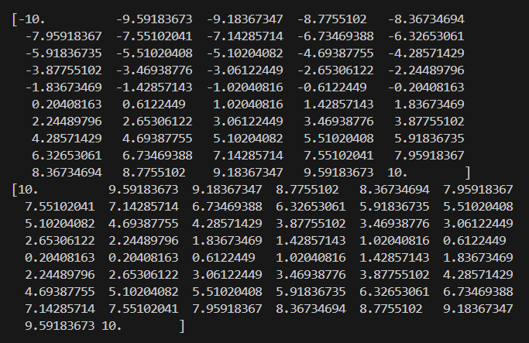


Run numpy_arrays.py
①
$$z$$
$$\left|z\right|$$
②

Slide 20
Edit numpy_arrays.py
You must type in this code
①
②
③
④
⑤
⑥

Slide 21
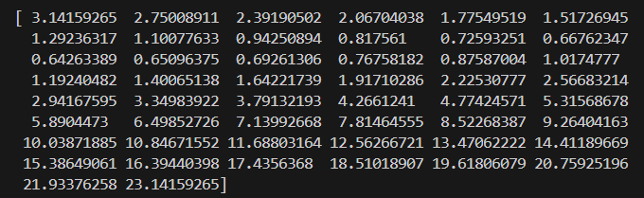



Run numpy_arrays.py
①
☑
$$=y∙z+π$$
$$y\left[1\right]=0.04081633$$
$$z\left[1\right]=−9.59183673$$
$$\left(0.04081633\right)\left(−9.59183673\right)+3.14159265=2.75008911$$
☑

Slide 22
Edit numpy_arrays.py
You must type in this code
①
②
③
④
⑤
⑥
⑦
⑧
⑨

Slide 23
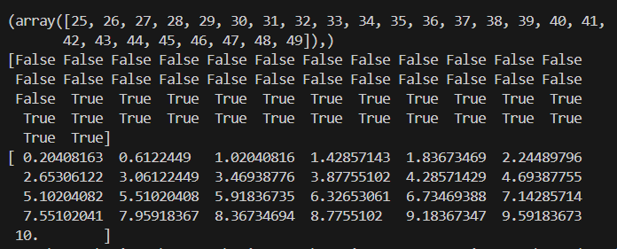
Run numpy_arrays.py
z = np.linspace(-10, 10)
①
Conditional Indexing
②
Vectorized comparison
②
Boolean/Fancy indexing (where mask = True)
print(np.where(z > 0)) # Indices where condition is True
print(z > 0) # Boolean array
print(z[z > 0]) # Values where condition is True

Slide 24
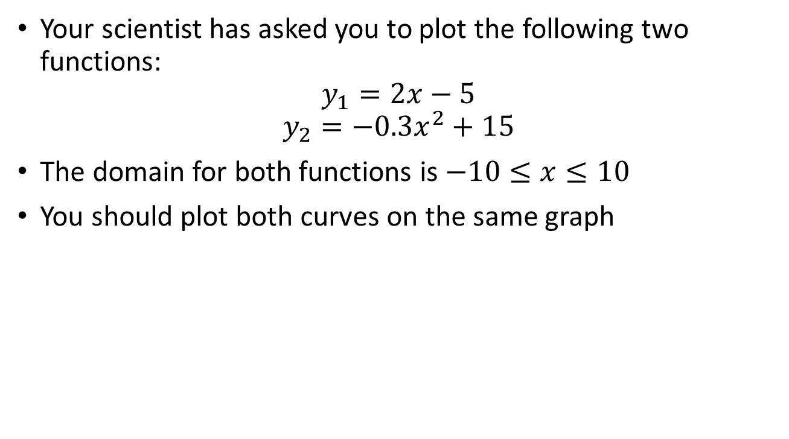
Line Graphs using matplotlib
Your scientist has asked you to plot the following two functions:
$$y_{1}=2x−5$$
$$y_{2}=−0.3x^{2}+15$$
The domain for both functions is $−10≤x≤10$
You should plot both curves on the same graph

Slide 25
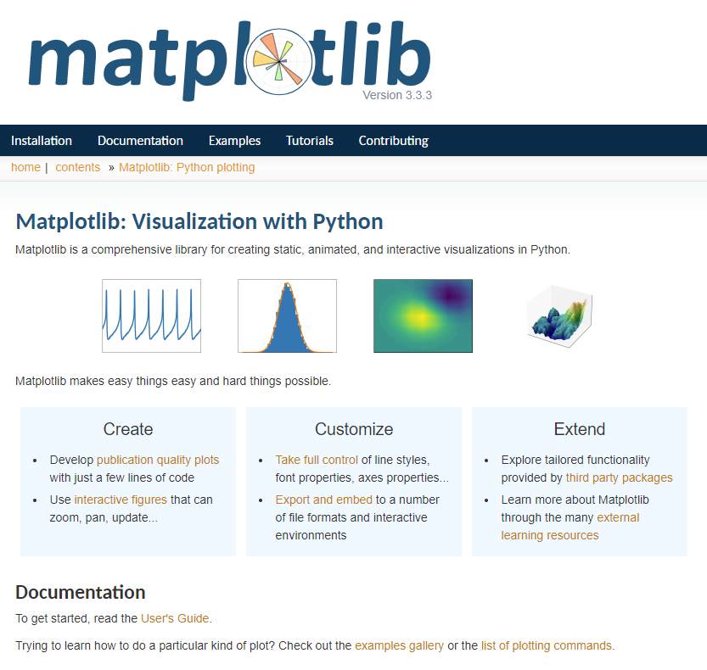
https://matplotlib.org

Slide 26
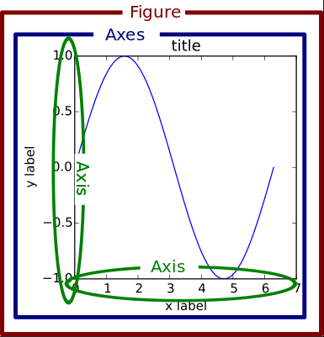
Matplotlib Container Hierarchy

Slide 27
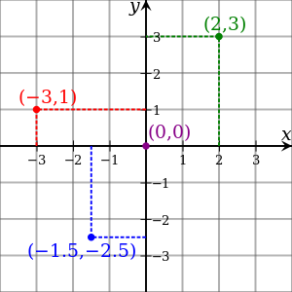
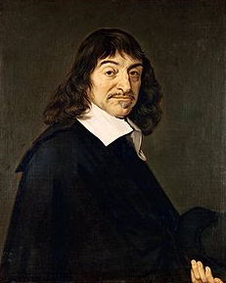
Cartesian Coordinates
Created by René Descartes in 1637

Slide 28
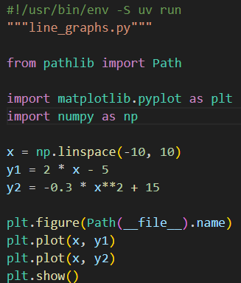
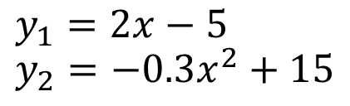
Open line_graphs.py
You must type in this code
①
②
③
④
x is now an array containing 50 numbers between -10 and 10
⑤
⑥
⑦
⑧
⑨
y1 and y2 are now arrays containing 50 numbers
⑩
Vectorized Operations in NumPy

Slide 29
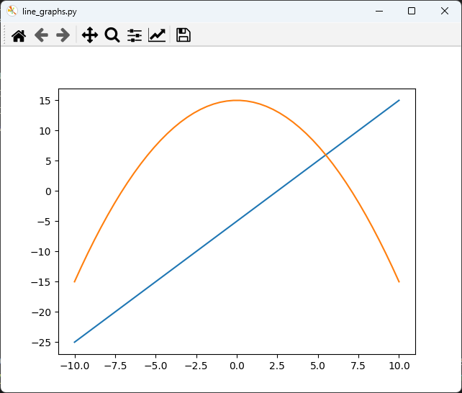
Run line_graphs.py
You must close the plot window

Slide 30


Plotting a Parabola
Your scientist has asked you to plot $y=x^{2}+1$
The domain is $−4≤x≤5$
Make the line color Olive Drab – like old US Army uniforms
Dave Biersach
West Point 1988

Slide 31
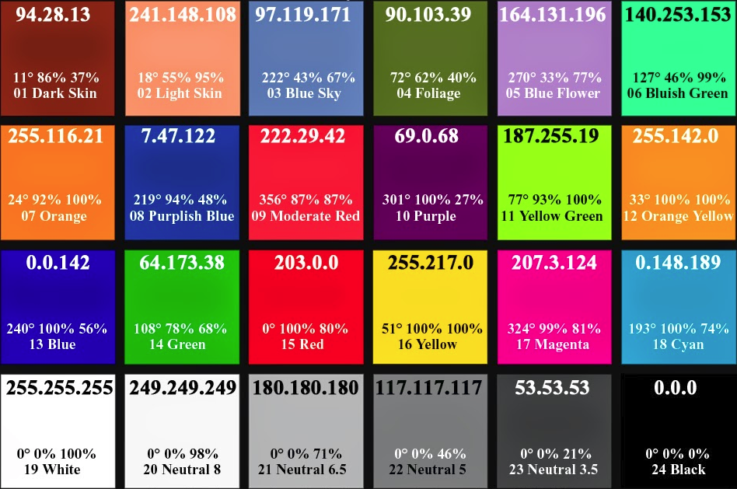
Various Colors in RGB Values

Slide 32

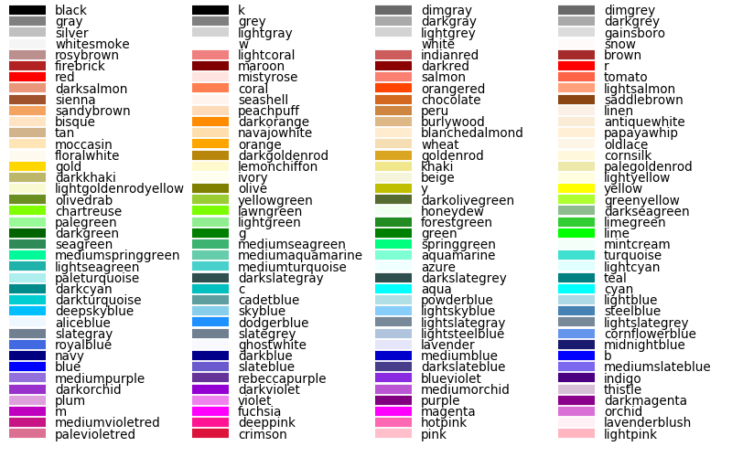
Colors “Names”

Slide 33
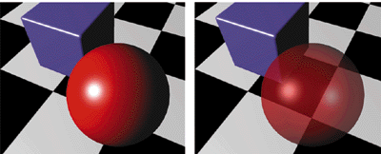
Alpha Blending = Opacity
Alpha = 0 means fully transparent (see through)
Alpha = 255 means fully opaque

Slide 34
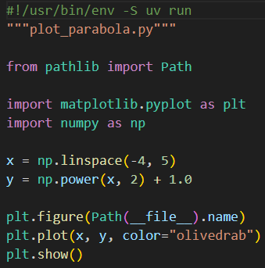


Open plot_parabola.py
DO NOT edit
this code
①
②
③
④
$$−4≤x≤5$$
⑤
$$y=x^{2}+1$$
⑥
⑦
⑧

Slide 35
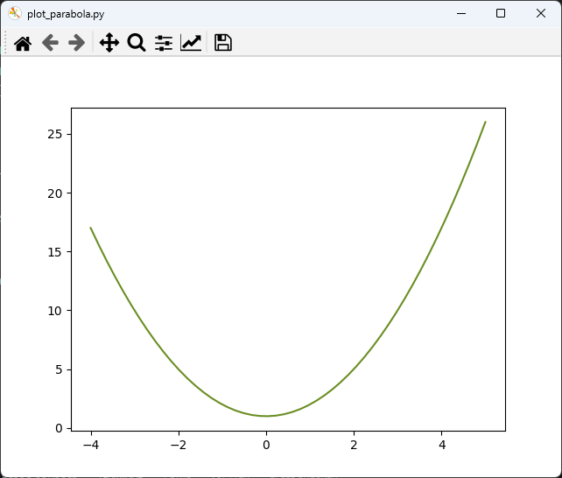
Run plot_parabola.py
You must close the plot window

Slide 36
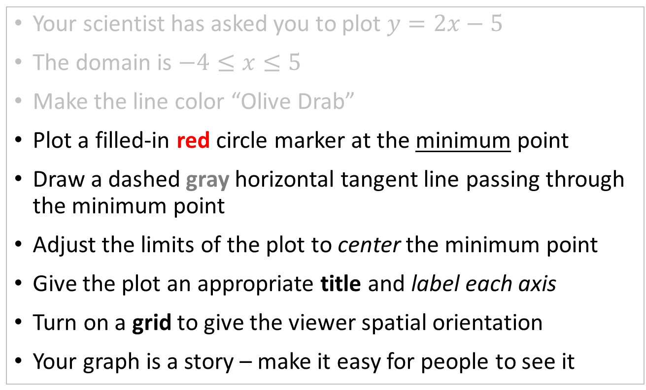
Make a Professional Graph
Your scientist has asked you to plot $y=2x−5$
The domain is $−4≤x≤5$
Make the line color “Olive Drab”
Plot a filled-in red circle marker at the minimum point
Draw a dashed gray horizontal tangent line passing through the minimum point
Adjust the limits of the plot to center the minimum point
Give the plot an appropriate title and label each axis
Turn on a grid to give the viewer spatial orientation
Your graph is a story – make it easy for people to see it

Slide 37
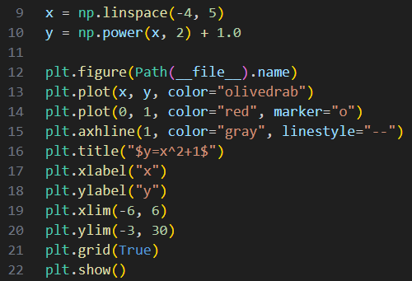

Edit plot_parabola.py
You must type in this code
①
②
③
④
⑤
⑥
⑦
⑧
You must type in (add) the lines in the white rectangle

Slide 38
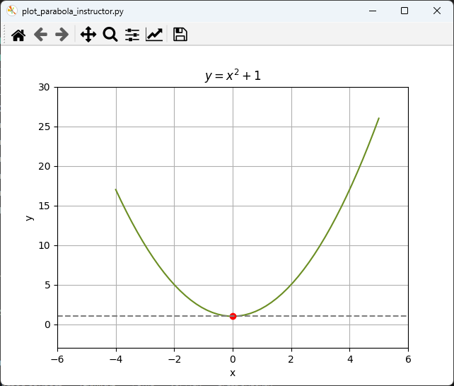
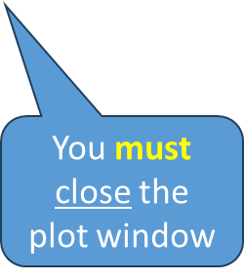
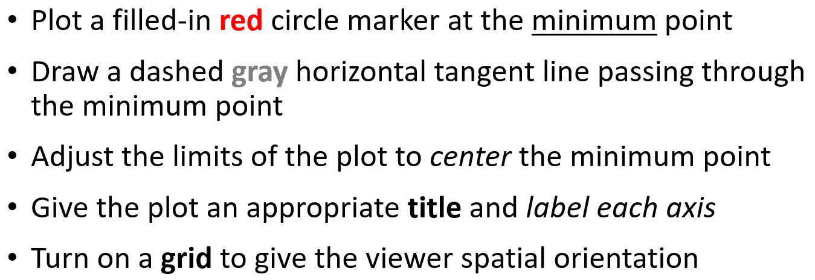
Run plot_parabola.py

Slide 39

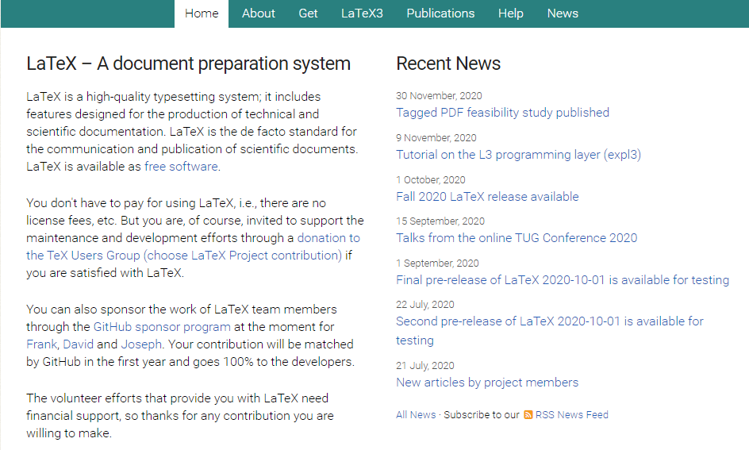
https://www.latex-project.org

Slide 40
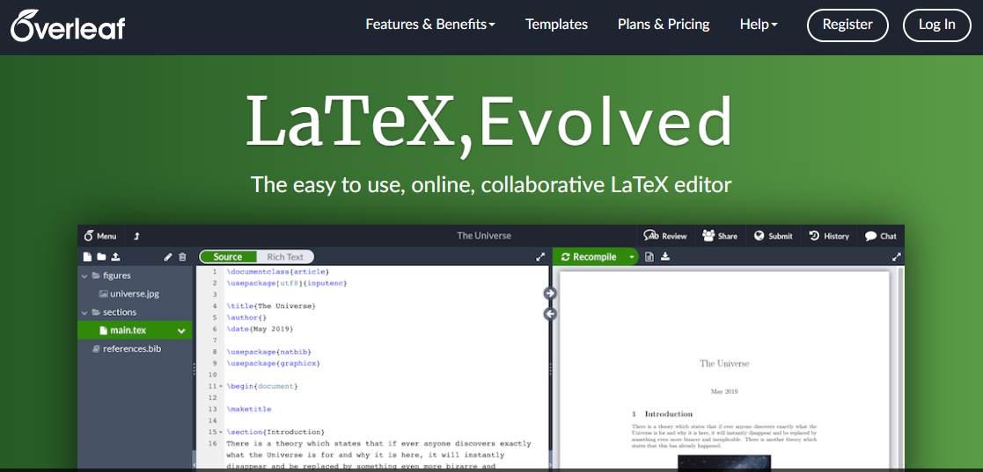
https://www.overleaf.com

Slide 41
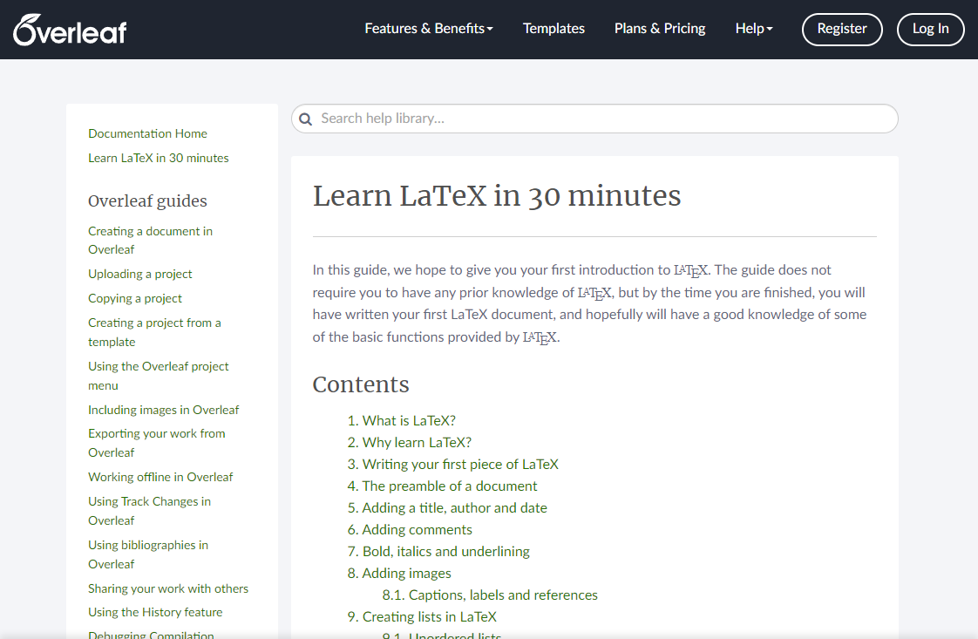
https://www.overleaf.com/learn/latex/Learn_LaTeX_in_30_minutes

Slide 42
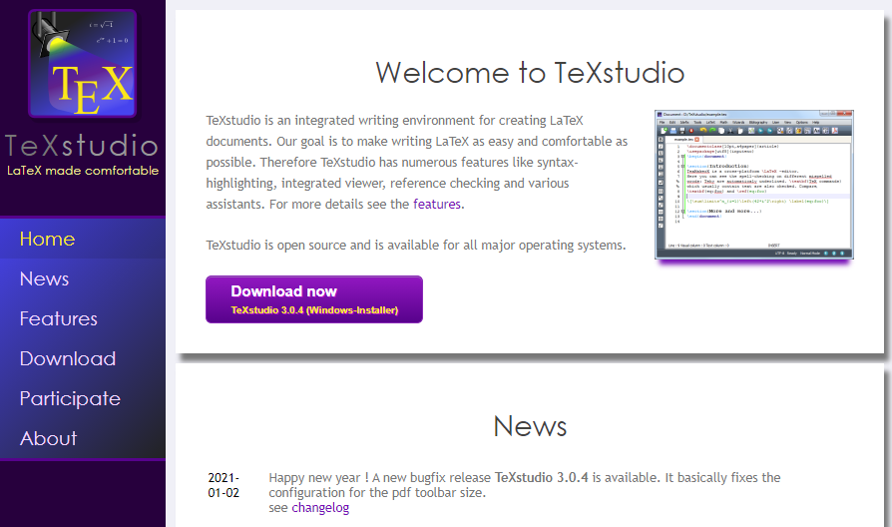
https://www.texstudio.org
100% free – runs on Windows, Mac, Linux

Slide 43
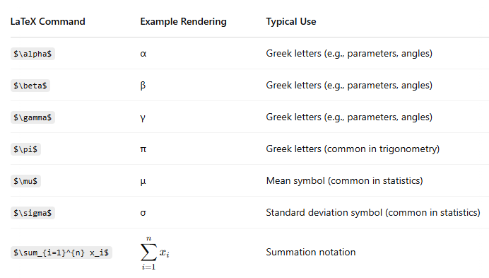
Example LaTeX Commands in matplotlib

Slide 44
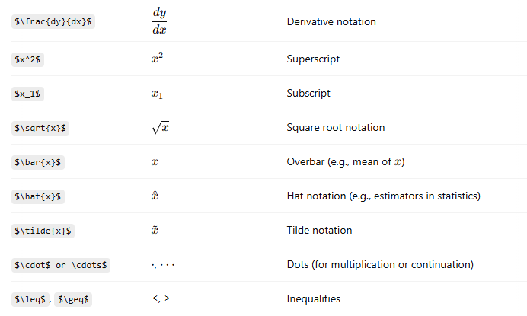
Example LaTeX Commands in matplotlib

Slide 45
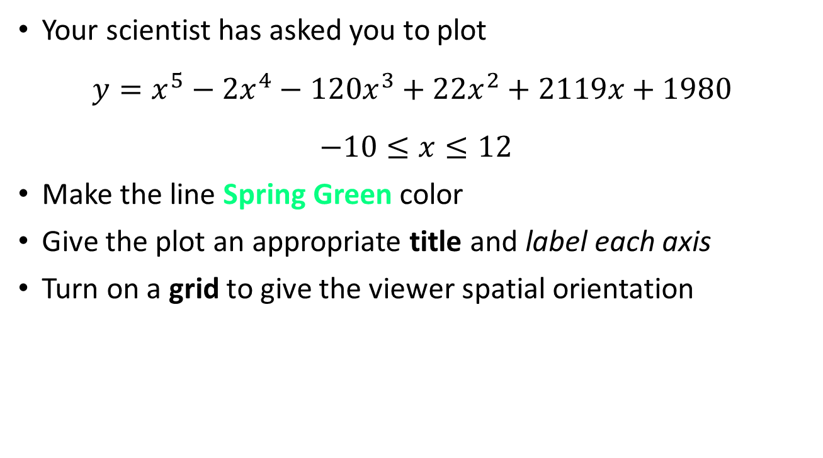
Plotting a Quintic
Your scientist has asked you to plot
$$y=x^{5}−{2x}^{4}−120x^{3}+22x^{2}+2119x+1980$$
$$−10≤x≤12$$
Make the line Spring Green color
Give the plot an appropriate title and label each axis
Turn on a grid to give the viewer spatial orientation

Slide 46
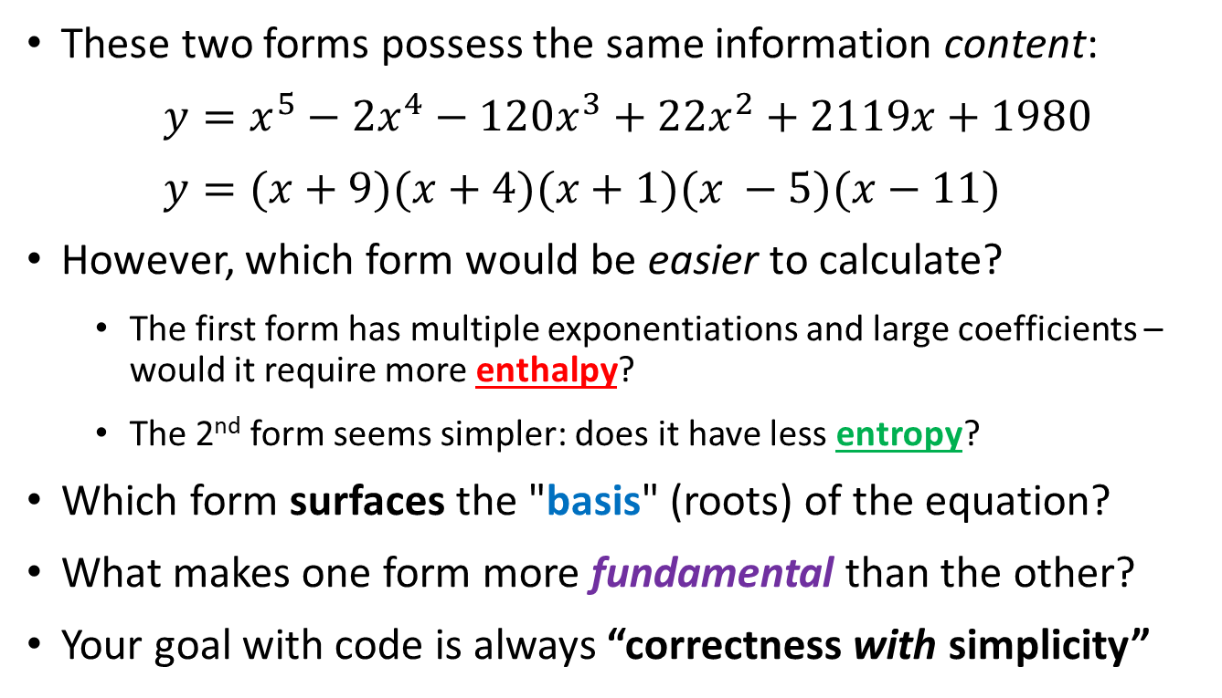
The Thermodynamics of Calculation
These two forms possess the same information content:
$y=x^{5}−{2x}^{4}−120x^{3}+22x^{2}+2119x+1980$
$$y=(x+9)(x+4)(x+1)(x −5)(x−11)$$
However, which form would be easier to calculate?
The first form has multiple exponentiations and large coefficients – would it require more enthalpy?
The 2nd form seems simpler: does it have less entropy?
Which form surfaces the "basis" (roots) of the equation?
What makes one form more fundamental than the other?
Your goal with code is always “correctness with simplicity”

Slide 47
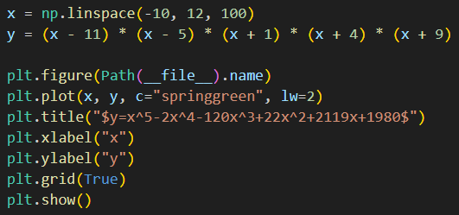
Open plot_quintic.py
DO NOT edit
this code
①
②
“dunder” = double underscore
dunder variables
dunder methods
③
④
⑤
⑥
⑦
⑧
https://docs.python.org/3/library/pathlib.html
https://www.pythonmorsels.com/dunder-variables

Slide 48
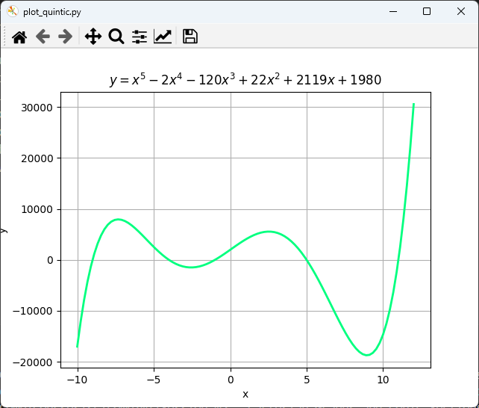

Run plot_quintic.py

Slide 49
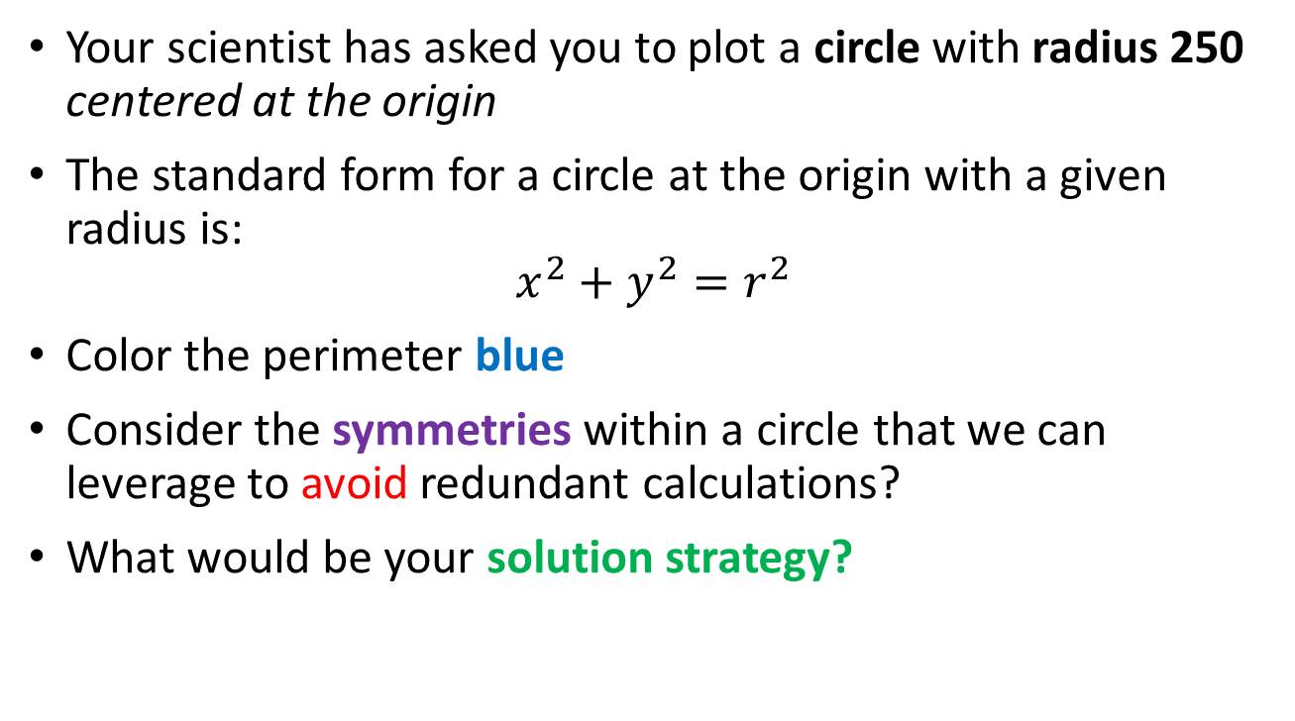
Plotting a Circle
Your scientist has asked you to plot a circle with radius 250 centered at the origin
The standard form for a circle at the origin with a given radius is:
$$x^{2}+y^{2}=r^{2}$$
Color the perimeter blue
Consider the symmetries within a circle that we can leverage to avoid redundant calculations?
What would be your solution strategy?

Slide 50



Open plot_circle.py
DO NOT edit
this code
①
②
③
$$x^{2}+y^{2}=r^{2}$$
$$y=\sqrt{r^{2}−x^{2}}$$
④
⑤
Symmetries!
⑥
⑦
⑧
⑨
⑩

Slide 51

Run plot_circle.py

Slide 52

Plotting an Ellipse
Your scientist needs you to write a program to draw an ellipse
The standard form of an ellipse centered at the origin is
$$\frac{x^{2}}{a^{2}}+\frac{y^{2}}{b^{2}}=1$$
Your ellipse should have $a=250$ (semi-major axis) and $b=150$ (semi-minor axis)
With these parameters, this ellipse will be oriented such that the major axis is aligned along the x-axis of the Cartesian plane

Slide 53



Open plot_ellipse.py
DO NOT edit
this code
①
$$\frac{x^{2}}{a^{2}}+\frac{y^{2}}{b^{2}}=1$$
②
③
$$y=b\sqrt{1−\frac{x^{2}}{a^{2}}}$$
④
Symmetries!
⑤
⑥
⑦
⑧

Slide 54

Run plot_ellipse.py
Symmetries!

Slide 55
Temperature Conversion
Your scientist has asked you to plot the Fahrenheit and Celsius temperature equivalents for temperatures in Kelvin that span from 0K to 400K inclusive
Your plot should label the line graph of each temperature scale and show a legend to ease plot comprehension
As with all professional graphs, each axis should be labeled with the appropriate units
The graph should have a title and a grid for easier reading of the values
The research question is, "What is the one temperature that is the same in Fahrenheit and Celsius?"

Slide 56

Open plot_temperature_scales.py
DO NOT edit
this code
①
②
③
④
⑤
⑥
⑦
⑧

Slide 57


Run plot_temperature_scales.py
$${−40}^{°}$$
What is the one temperature that is the same in Fahrenheit and Celsius?

Slide 58
Session 05 – Now You Know…
How to create arrays using np.linspace()
That vectorized operations in NumPy implicitly operate on an entire array with just one algebraic expression
We can use NumPy’s slicing syntax to extract specific subarrays from a larger array
How to plot 2-D equations using the Python package matplotlib and its pyplot module
How to plot curves using Cartesian coordinates
That LaTeX can display proper mathematical symbols

Slide 59
Session 05 – Now You Know…
How to create numpy arrays to hold the independent and dependent variable values
How to translate the mathematical equations (standard forms) of the parabola, circle, and ellipse conic sections into Python code
We can leverage the symmetries in conic sections to reduce the calculations required to plot each curve
Plotting the Fahrenheit and Celsius scales versus the Kelvin scale makes it easy to visually determine the one temperature with equal enthalpy on both scales

Slide 60

Task 05
Create a new Python program called plot_hyperbola.py
The program should plot the standard hyperbola:
$$\frac{x^{2}}{a^{2}}−\frac{y^{2}}{b^{2}}=1$$
Use the values of $a=5$ and $b=2$
Plot over the domain $−50≤x≤50$
Make the hyperbola blue and include the grid
Use LaTeX to show the equation in the title of the plot

Slide 61

Task 05 (hint)

